Slide 1

BIG DATA IN HEALTHCARE
Presented by – Sheethal H S

Slide 2
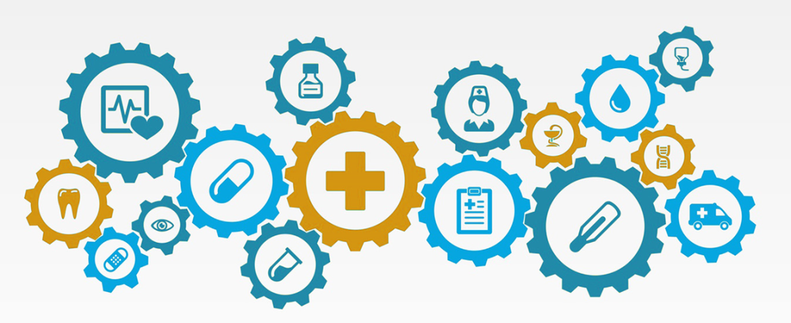
INDEX
What is big data?
Why big data in healthcare?
Sources of medical data
How is big data used?
Barriers exist in using big data
Solutions
Big data: a new era in healthcare
Future of big data in healthcare

Slide 3
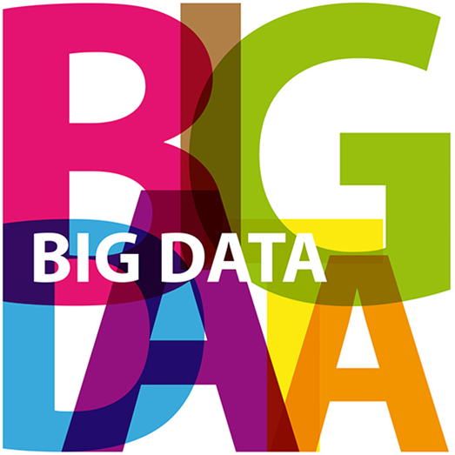
WHAT IS BIG DATA?
'Big Data' is that everything we do is increasingly leaving a digital trace (or data), which we can use and analyse.
Ability to make use of the ever-increasing volumes of data.

Slide 4

Why Big Data in Healthcare?
Predictive analytics- new cures,better understand and predict disease patterns.
Data science in patients monitoring they’re own condition.
Data from smart watches and wearable devices –a link between lifestyles and diseases.
Big data analytics to monitor and predict epidemics and disease outbreaks .
Based on searching on the Internet.

Slide 5
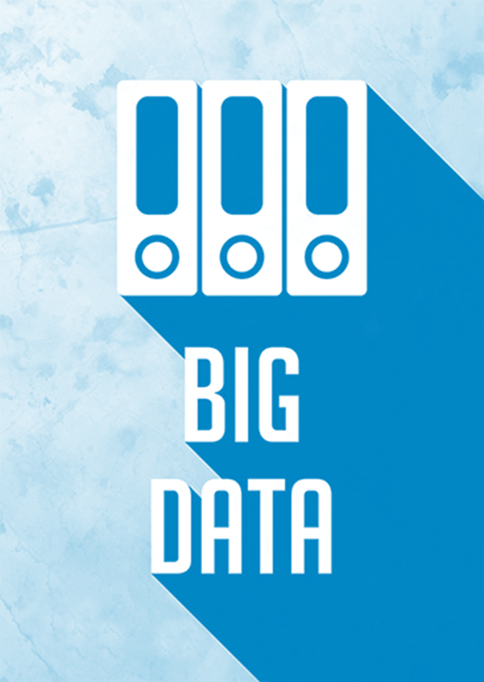
Sources for Medical data
The data for clinical research - electronic health records (EHR).
EHR designed to store range of data (medical history, immunization status, lab test results, radiology images)
It reduces data replication and records can be shared through network connected .
BIG DATA is the tool for medical science just like stethoscope, ECG or thermometer.
We can collect data like heart rate, temperatures,weight, ECG using medical instruments .

Slide 6
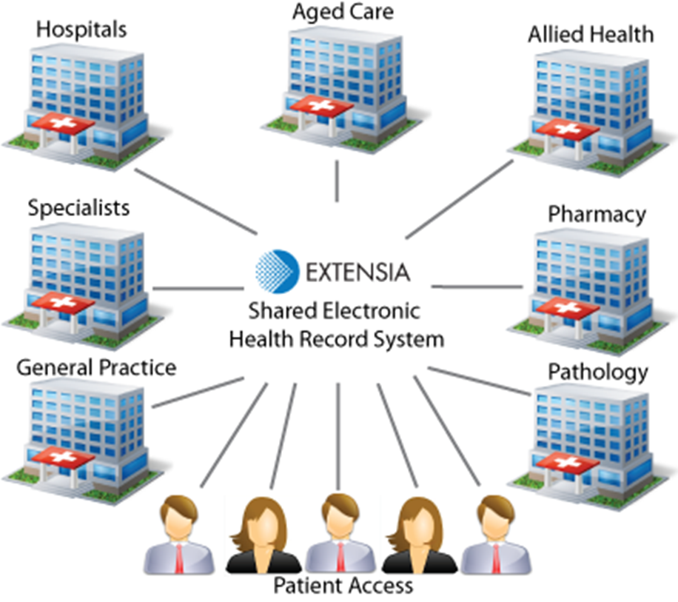
Electronic Health Record

Slide 7
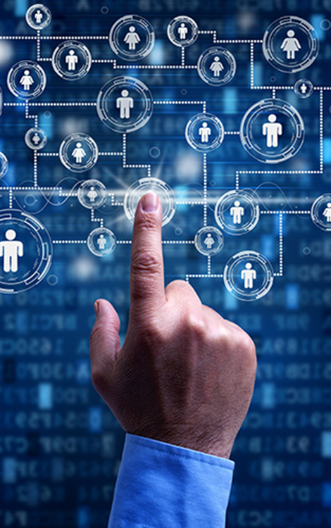
How is Big Data used?
Cleaver usage of data to make better decisions for the medical science and health industry.
Monitor the safety of drug treatment.
Better understand diseases, and develop drugs and treatments that can change lives.
Some EMR systems automatically monitor clinical events by analysing patient data from an EHR to predict, detect events.

Slide 8
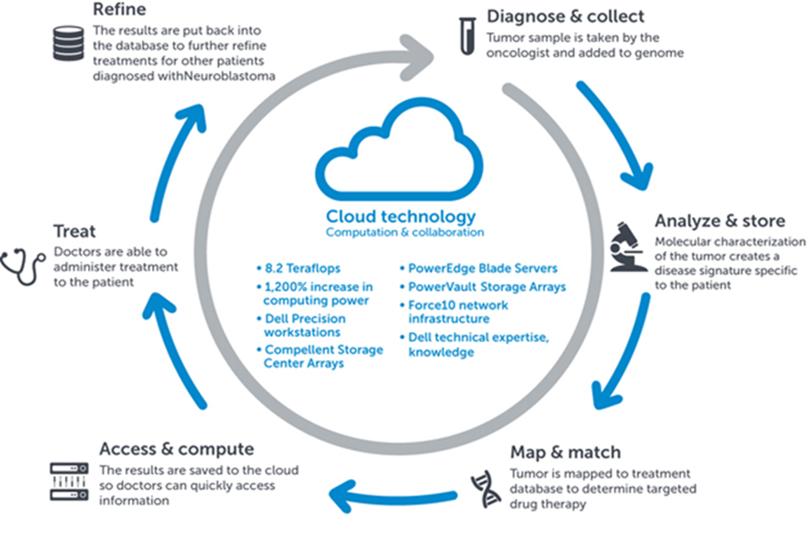
How is big data used?

Slide 9
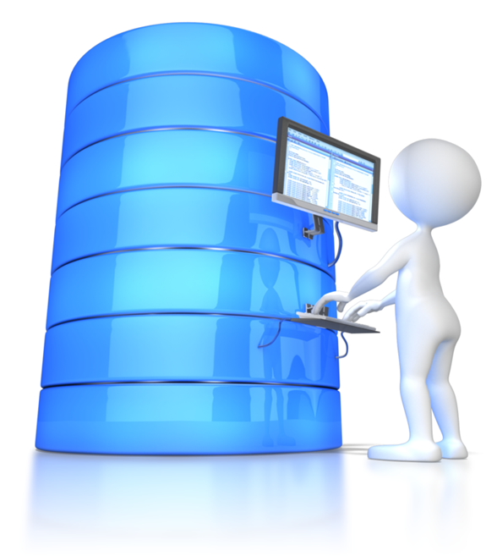
Barriers exist in using Big Data?
Expertise
The value for big data in healthcare today is largely limited to research because using big data requires a very specialized skill set.
Hospital IT experts aren’t prepared.
Data scientists being hard to come by and expensive.

Slide 10
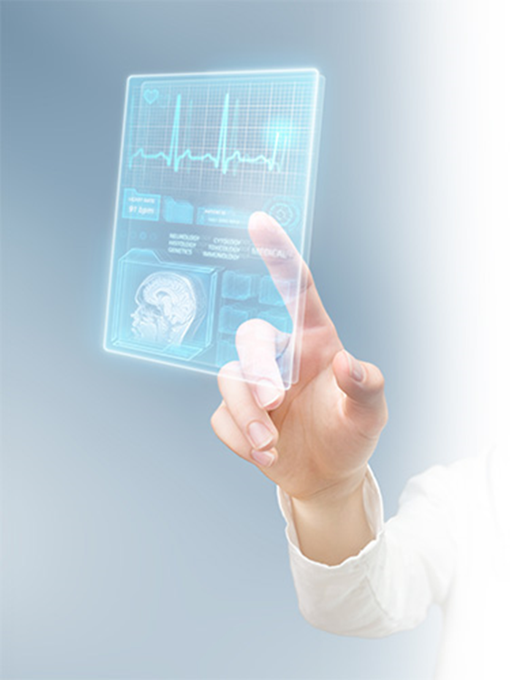
Barriers exist in using Big Data?
Security
HIPAA compliance is non-negotiable as part of privacy and security of patient data.
When opening up access to a large, diverse group of users, security cannot be an afterthought.

Slide 11

Solutions
People with less-specialized skillsets will be able to easily work with big data in the future.
Big data is coming to embrace SQL as the lingua franca for querying.
A well-supported, commercial distribution over raw Apache distribution.
Another option is to select a cloud-based solution like Azure HDInsight to get started quickly.

Slide 12
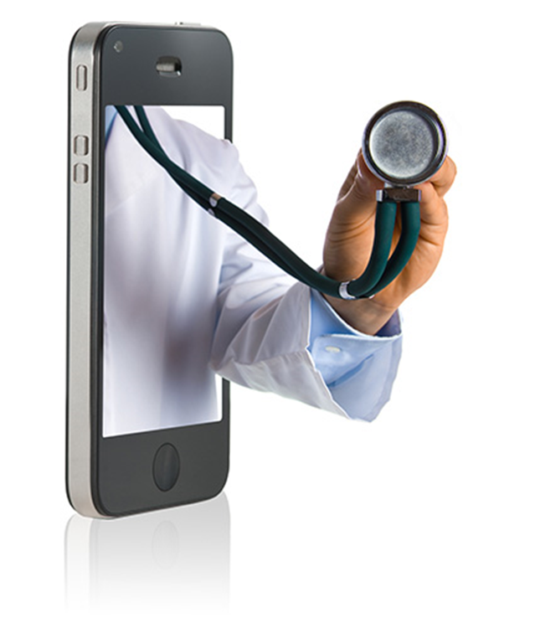
Big data : A new era in healthcare
Companies use real time data sources like google fly trends, twitter trends and temperature forecasts to predict when products will be in high demand.
Use of web based software.

Slide 13
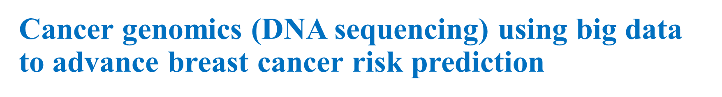


Big data : A new era in healthcare
Google to Tackle Diabetes Using Big Data and Internet of Things
-Infographics

Slide 14
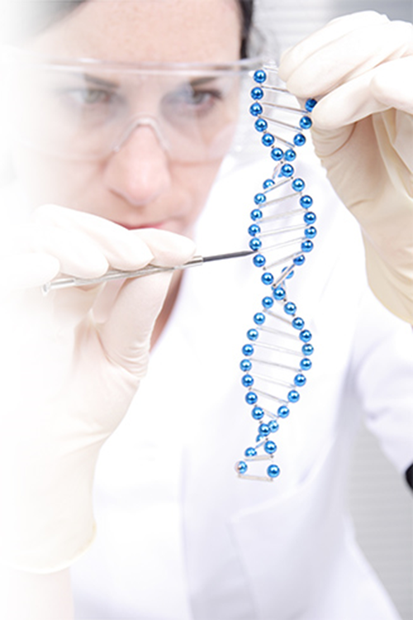
Future of BIG DATA in Healthcare
Penn Medicine taps big data to save lives: Penn medicine’s modern big data initiatives applications alert doctors of at-risk patients.
Future of early cancer detection using micro RNA detection -molecular data gathering, analysing and interpretation.
CIS

Slide 15

Any Questions???

Slide 16


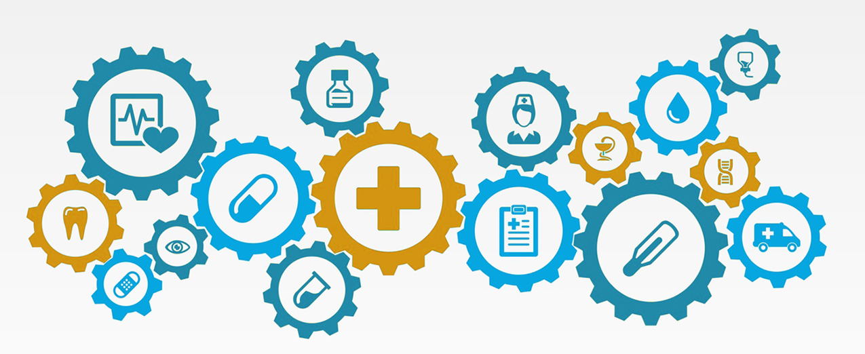
THANK YOU

